Slide 1
HOPE AGAINST TRAFFICKING
TEANA Conference
July 14, 2018

Slide 2
What is Human Trafficking?
Human trafficking involves recruitment, harboring and/or transporting people into a situation of exploitation through the use of violence, deception or coercion and forced to work against their will
Human trafficking is a form of modern slavery
Human trafficking is a multi-dimensional problem: it is a human rights issue, it is a public health issue and it is a public safety issue
All trafficking victims share one essential experience: the loss of freedom

Slide 3
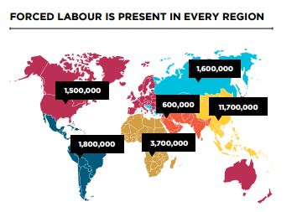
Global Human Trafficking Facts
A $150bn industry that denies freedom to 20.9 million people around the world
$99bn from commercial sexual exploitation; $34bn in construction, manufacturing, mining and utilities; $9bn in agriculture, including forestry and fishing; $8bn is saved annually by private households that employ domestic

Slide 4
Global Human Trafficking Facts
After drug dealing, it is the 2nd largest crime and fastest growing industry globally
The most common form of human trafficking (79%) is sexual exploitation
The victims of sexual exploitation are predominantly women and girls
There is a victim of trafficking every sixty seconds
Nearly every country is involved in the web of trafficking activities
Up to 2mn new victims annually
12-14 is the average age victims are lured, sold, or taken into trafficking
The present rate of child trafficking is 10X the trans-Atlantic slave trade at its peak
According to the 2017 State Department Trafficking in Persons (TIP) report, there were only 14,894 prosecutions and 9,071 convictions for trafficking globally in 2016

Slide 5
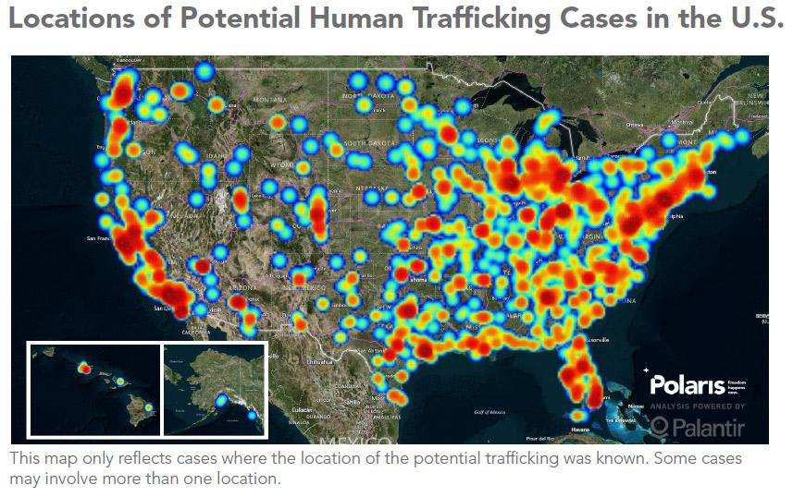
Closer to Home: Polaris’ Cross Country
Every 10 minutes, a woman or child is trafficked into the US
Reports of human trafficking in the US increase every year. In 2016, we learned of 8,042 cases of human trafficking, a 35% jump over 2015
More survivors of human trafficking are reaching out for help than ever before. 2,042 survivors contacted the Hotline directly in 2016, a 24% increase over 2015
In 2016, the Department of Justice convicted a total of 439 human traffickers, up from 297 in 2015 and 184 in 2014
TAKE ACTION: ADD POLARIS HUMAN TRAFFICKING HOTLINE NUMBER
TO YOUR CELL PHONE: 1-888-373-7888
TEXT: Polaris BeFree Textline Text "BeFree" (233733)

Slide 6
Michigan: Closer To Home
Michigan’s proximity to the Canadian border and waterways increases the likelihood of trafficking in the state
Human trafficking exists in every zip code in Michigan
Cities in Michigan with the most calls received by Polaris Project include: Detroit, Grand Rapids, Ann Arbor, Kalamazoo, Lansing, Mackinac Island
It is currently estimated that there are over 1,200 women currently being trafficked in Detroit within a 3 mile radius.
Southeast Michigan Trafficking and Exploitation Task Force
74 open federal investigations
152 state investigations initiated
162 arrests

Slide 7
Michigan: Closer To Home
Situational Trends (Polaris, 2017)
Female 249; Male 35
Adult 191; Minor 96
US Citizens 75; Foreign 30
Sex Trafficking
Residence-Based Commercial Sex
Hotel/Motel Based
Internet Based Commercial Sex
Illicit Massage/Spa Business
Labor Trafficking
Illicit Activities
Agricultural/Farms
Construction
Domestic Work

Slide 9
How do we Combat Human Trafficking?

Slide 10
HAT’s Objectives
CORE OBJECTIVES
Respond to the physical, emotional and psychological needs of adult female human trafficking victims
Move survivors toward independent living through education, job skill development, life skills coaching, goal setting, budget development, and a matching savings program
Educate survivors of their legal rights within the criminal justice system through advocacy, referrals and accompaniment to relevant services
Create awareness and training in the surrounding communities to inform the public about how to identify trafficking victims and how they can best support their spectrum of needs as volunteers
Start a justice enterprise to empower the women to ear and save wages which imparts job skills ad puts into practice all of the above
TRANSFORMATION & INDEPEDENCE
…We will serve as advocates and leverage community services where possible.

